Slide 1
Power BI Dashboard Summary
By Abhishek Gudesaria

Slide 2
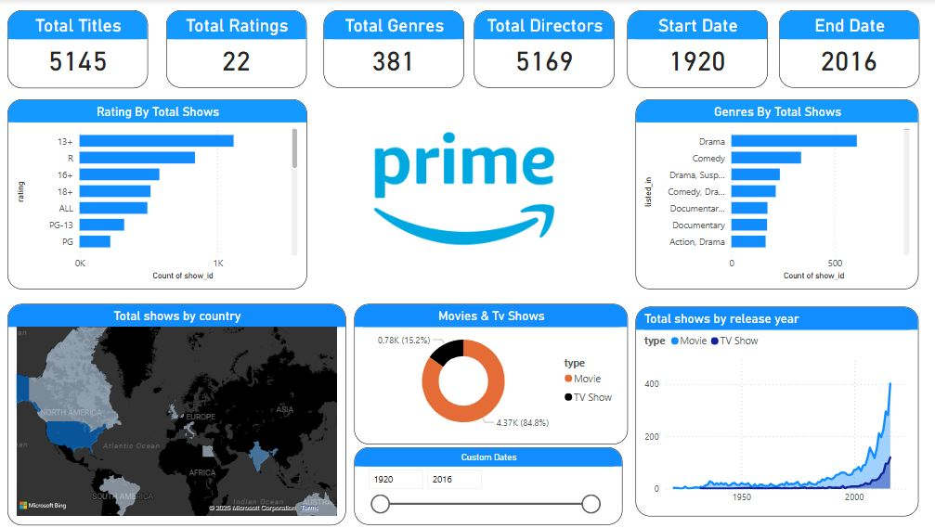
Dashboard Overview

Slide 3
Cards for Quick Data
I used cards to represent an over estimate of data.

Slide 4
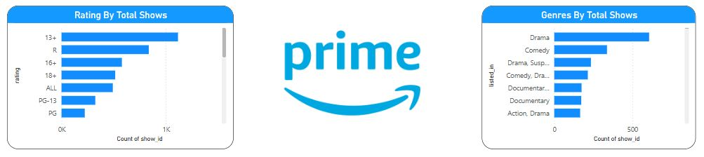
Stacked Bar Chart
Stacked bar chart here is used to indicate two scenarios. One is Rating by Total Shows and Genres by Total Shows.

Slide 5
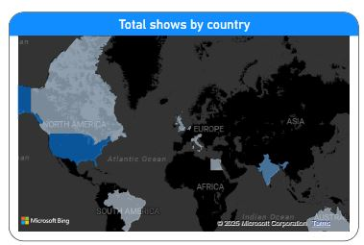
Filled Map
I used filled map to indicate the shows that streamed in different parts of the world. Conditional formatting/Gradient is applied.

Slide 6
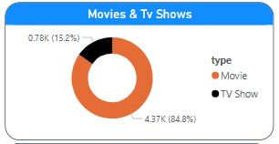
Donut Chart
I used Donut Chart to indicate what percentage of movies and TV shows are people interested to watch.

Slide 7

Slicer
I used this Slicer for custom dates as in to check the data for whichever year the user want.

Slide 8
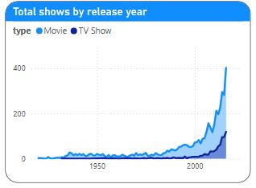
Area Chart
I used Area Chart to indicate comparison between the number of movies and TV shows released between years.

